Slide 1
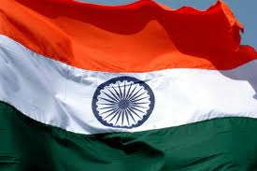
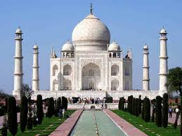
INDIA
By: Yesica Varela &
Moises Carrillo

Slide 2
Geographic's
India is in South Asia
Current Population of India in 2010 is around 1,150,000,000 (1.15 billion) people. Currently, India is second largest country in the world after China in terms of population. By 2030.(3)
The weather is hot most of the year depending from region to region. The coolest weather lasts from around December to February, with fresh mornings and evenings and mostly sunny days.(4)

Slide 3
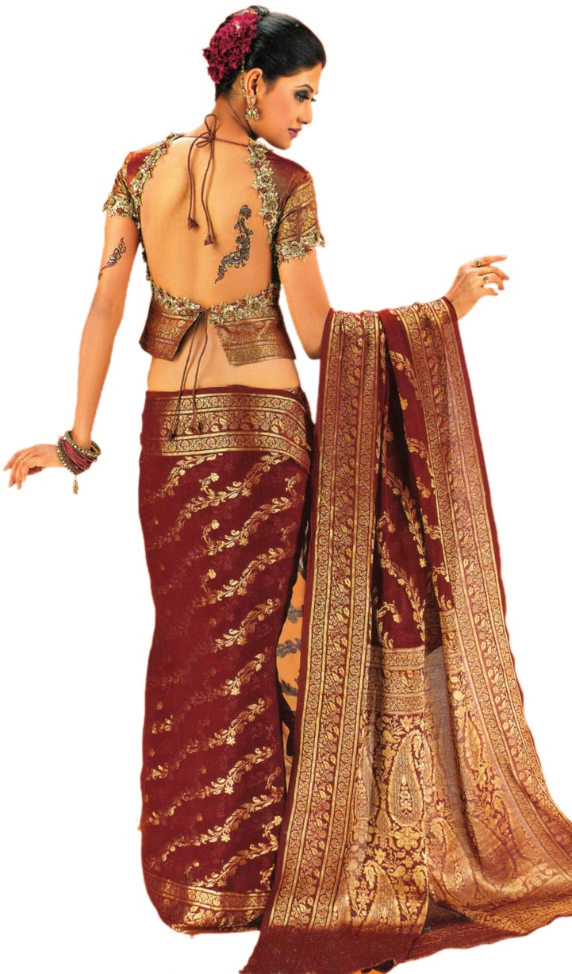
Women Clothes
They wear saris they are 6m long and 2m board scarf.
It demands skill to dress oneself.
The material of the Saris changes from occation(1)

Slide 4
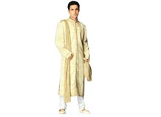
Men’s Clothing
Men where long wide shirts.
Also where trousers (material) according to occasions
(1)

Slide 5
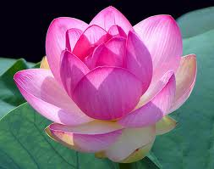
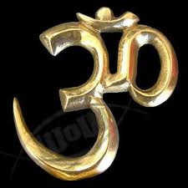
Religion & Belifs
Hinduism
Buddhism
Islam
Sikkism
Christianity
Jainism
Zoaroastrianism
(1)

Slide 6
Hinduism
Hinduism is one of many of the religions in India.
Hinduism is a dominant faith, practiced by over 80% of the population.
The true name for the religion is “vaidic” not “Hindu”.
The three main gods are Krishna, Shiva and Vishnu.
One of their big Belifs is in Reincarnation, which means rebirth.
Faithful Hindus are strict vegetarians (1) Every Hindu at least once in his life should go to Varanasi to take a holy bath in “mother Ganges” and to pry to lord Shiva, the creator of the universe.
Varanasi is also there favorite place to die, as Hindus believe they will gain salvation automatically.
When a Hindu dies there ashes will be merged in the sacred waters of “Mother Ganga”(1)

Slide 7
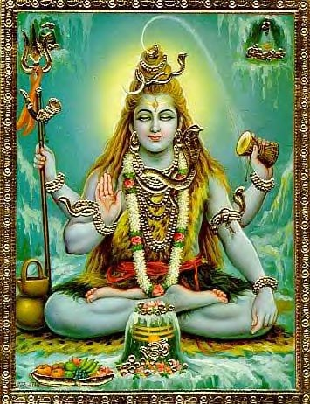
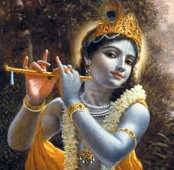
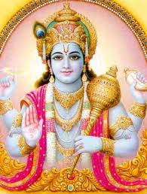
Shiva
Vishnu
Krishna

Slide 8
Vishnu Baby
Poona, who gave birth to Larksome on the celebration day of the four-armed Hindu goddess of wealth and prosperity after whom the new born was named, said: "She is a miracle, a special blessing from God. But she is my daughter and she cannot live like this.”(5)

Slide 9
Foods
In North India their main dishes consists of wheat.
South India’s food are mainly made of rice.
Most east Indians have an innate bond with anything sweet.
The typical Gujrati "thali" consists of at least 10 different varieties of vegetables alone! The people of Maharashtra prepare a dish called "puran poli" that is famous throughout the country. (2)

Slide 10
Work Cited
(1) http://www.sights-and-culture.com/india/india-reflections.html
(2)http://www.bharatonline.com/travel-tips/traditional-food.html
(3) http://www.indiaonlinepages.com/population/india-population.html
(4) http://www.worldtravelguide.net/india/weather
(5)http://www.dailymail.co.uk/news/article-491757/First-pictures-reveal-success-life-saving-surgery-toddler-limbs.html

